Slide 1
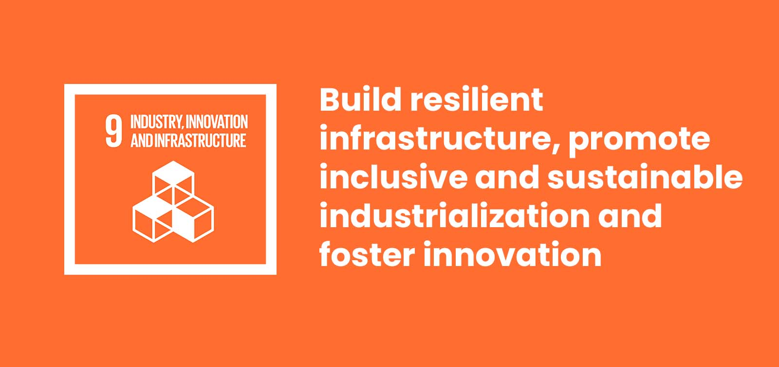

Slide 2
WPC SDG Group Activity (Group No.9)
WPC SDG Group Activity (Group No.9) WPC SDG Group Activity (Gro SDG Group Activity (Group No.9)up No.9)
PD-29 Divya Gugale
PD-32 Shikhar Shukla
PD-47 Yash Agarwal
Pe-29 Vasu Kalariya
GROUP MEMBERS

Slide 3
Root Causes
More than 4 billion people still do not have access to the Internet; 90 percent of them are in the developing world
In developing countries, barely 30 percent of agricultural products undergo industrial processing, compared to 98 percent high-income countries.
The renewable energy sectors currently employ more than 2.3 million people; the number could reach 20 million by 2030.
In some low-income African countries, infrastructure constraints cut businesses’ productivity by around 40 percent.
. 2.6 billion people in developing countries do not have access to constant electricity.

Slide 4
Solution
Through SDG 9, countries have determined that investing in more resilient infrastructure, cooperating across borders, and encouraging small enterprises will all be critical to ensuring sustainable industrial development.
Governments and businesses will have to contribute to creating a hospitable policy environment for innovation, encourage scientific research, and improve access to information technology universally..
Develop quality, reliable, sustainable and resilient infrastructure, including regional and trans-border infrastructure, to support economic development and human well being.
Promote inclusive and sustainable industrialization and, by 2030, significantly raise industry’s share of employment and gross domestic product, in line with national circumstances, and double its share in least developed countries.
Support domestic technology development, research and innovation in developing countries, including by ensuring a conducive policy environment for, inter alia, industrial diversification and value addition to commodities.

Slide 5
India's Contribution in Innovation
Education and universities have a massive role in consistently contributing to the innovation of their country, and India has already made improvements.
As of 2020, India’s top three universities scored 44.9 through the World University Rankings. This is very close to the final goal of reaching a score of 50.
The accessibility to information and, therefore, the betterment of education for all has also progressed through widespread internet access.
India’s population using the internet has grown from 17% in 2015 to 34.45% in 2017. It has doubled since the implementation of the sustainable development goals.

Slide 6
India's Contribution in Infrastructure
There has been a massive success in providing accessibility for the many rural areas within India.
As of 2017, 70% targeted rural areas to give them access to all-weather roads.
The overall construction of national highways has more than doubled, going from 4,410 kilometers in 2015 to 10,824 kilometers in 2019.
12 significant ports’ capacity to handle cargo has improved by 84% from 2015 to 2019. This provides the potential for trade and shipment performance to be at a much higher level.

Slide 7
India's Contribution in Industry
It has focused on making the business industry easier to enter, encouraging new businesses and growth.
The country has implemented business reform to improve its rank within the World Bank’s Ease of Doing Business.
In 2019, it ranked 63rd in comparison to 2015’s 142nd world ranking.
The number of design patents quadrupled from 2015 to 2019. This is a precursor to industry growth.
It has averaged a gross domestic product growth of 7.2% between the years 2018 and 2019.

Slide 8
Industry, Innovation and Infrastructure (Daily Actions)
Develop quality, reliable, sustainable and resilient infrastructure, including regional and trans-border infrastructure, to support economic development and human well being.
Promote inclusive and sustainable industrialization.
By 2030, significantly raise industry’s share of employment and gross domestic product, in line with national circumstances, and double its share in least developed countries.
Increase the access of small-scale industrial and other enterprises.

Slide 9
Industry, Innovation and Infrastructure (Daily Actions)
Upgrade infrastructure and retrofit industries to make them sustainable, with increased resource-use efficiency and greater adoption of clean and environmentally sound technologies and industrial processes, with all countries taking action in accordance with their respective capabilities.
Enhance scientific research, upgrade the technological capabilities of industrial sectors in all countries, in particular developing countries.
Facilitate sustainable and resilient infrastructure development in developing countries through enhanced financial, technological and technical support to least developed countries.

Slide 10
Industry, Innovation and Infrastructure (Daily Actions)
Support domestic technology development, research and innovation in developing countries, research and innovation in developing countries.
By ensuring a conducive policy environment for inter alia, industrial diversification and value addition to commodities.
Significantly increase access to information and communications technology and strive to provide universal and affordable access to the internet in least developed countries

Slide 11

Story on SDG Activity(Industry, Innovation and Infrastructure)
Brothers Return From Silicon Valley, Launch Low-Cost E-Bikes That go 35Km on One Charge

Slide 12
Story on SDG Activity(Industry, Innovation and Infrastructure)
The company’s vision is to introduce millennials and Gen Z to an active lifestyle, encouraging them to reclaim the outdoors and make cycling a part of their lifestyle
Make in India: In terms of sourcing, the startup claims that about 75% of the material is locally sourced and the rest is imported because of their non-availability in India. They obtain these “world-class” components from Taiwan and Cambodia.
This will take us closer to our dream of being completely ‘Made in India’. The battery packs are made at this facility and the controllers and motors are also sourced from strategic partners. We also have a very strong supply chain of various cycle components in India. Right from battery testing, wheel building with a rear hub motor, to battery assembly, internal cabling and online testing, everything has been developed by us.

Slide 13
Thankyou !!!

